Slide 1

Giffy
Mini Project II
Mentor: Mr. Amir Khan
Submitted by:
Priyanshu Upadhyay

Slide 2
OBJECTIVE
To build GIFFY Website using HTML, CSS and JavaScript. As memes culture is on boost, nowadays many people use memes not only for sharing purposes but also their response/reply is hidden in it. So here will be this website which will provide them some templates by which people can make their own stickers.

Slide 3
MOTIVATION
I am going to make a Giffy Website that helps us to search or make gifs /stickers which we use to express our current mood.
Also, here there will be thousands of gifs and stickers which they can download and the content provided by us will be updated as per the trending Content.

Slide 4
TECHNOLOGY AND TOOLS USED
HTML5
CSS3
JavaScript
Github
Visual Studio Code

Slide 5
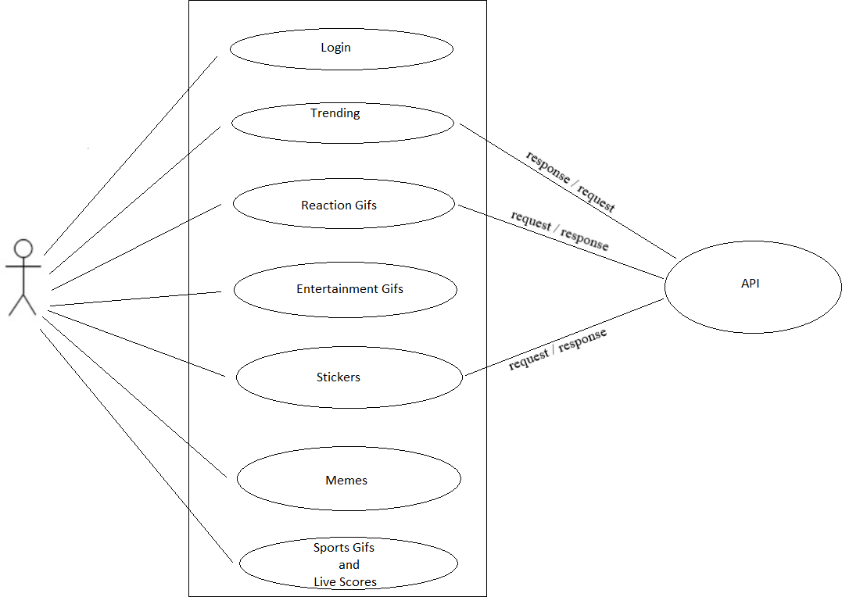
USE CASE DIAGRAM

Slide 6
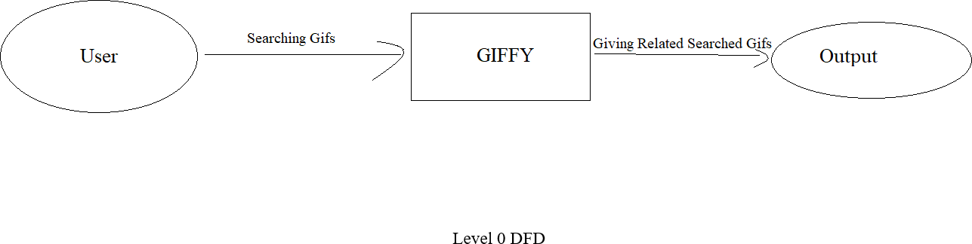
ZERO LEVEL DFD

Slide 7
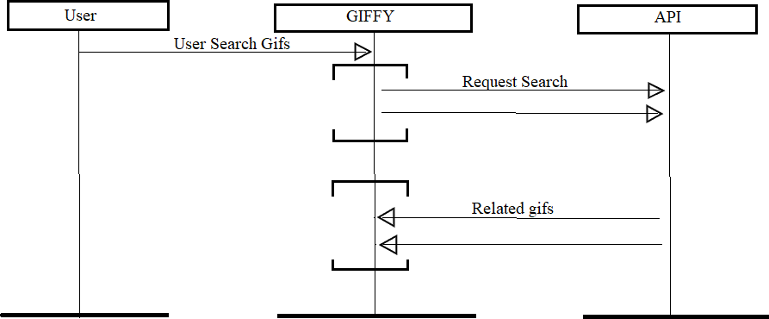
Activity Diagram

Slide 8
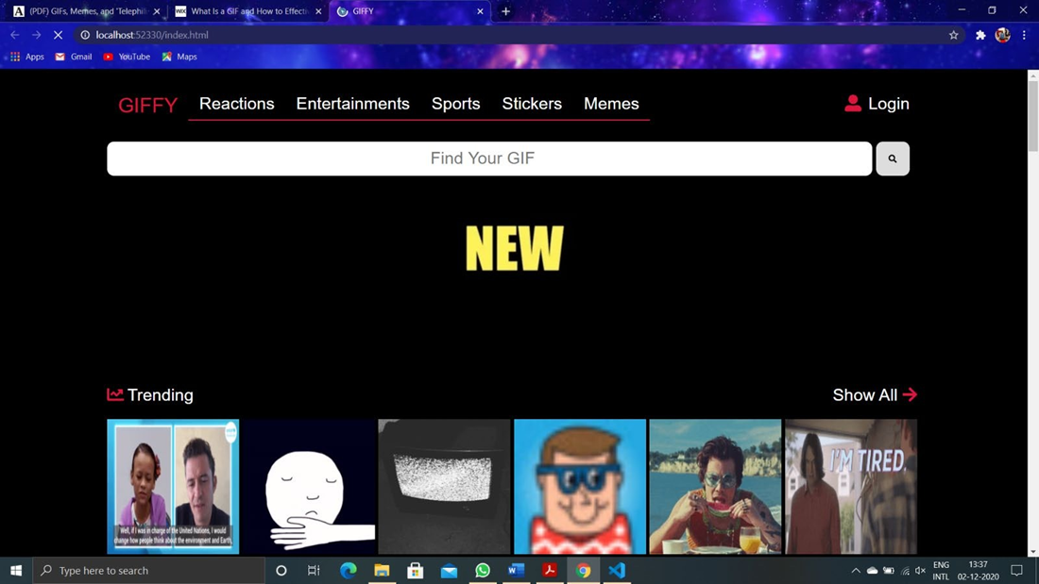
LANDING PAGE
This is the page first webpage that the user will see.

Slide 9
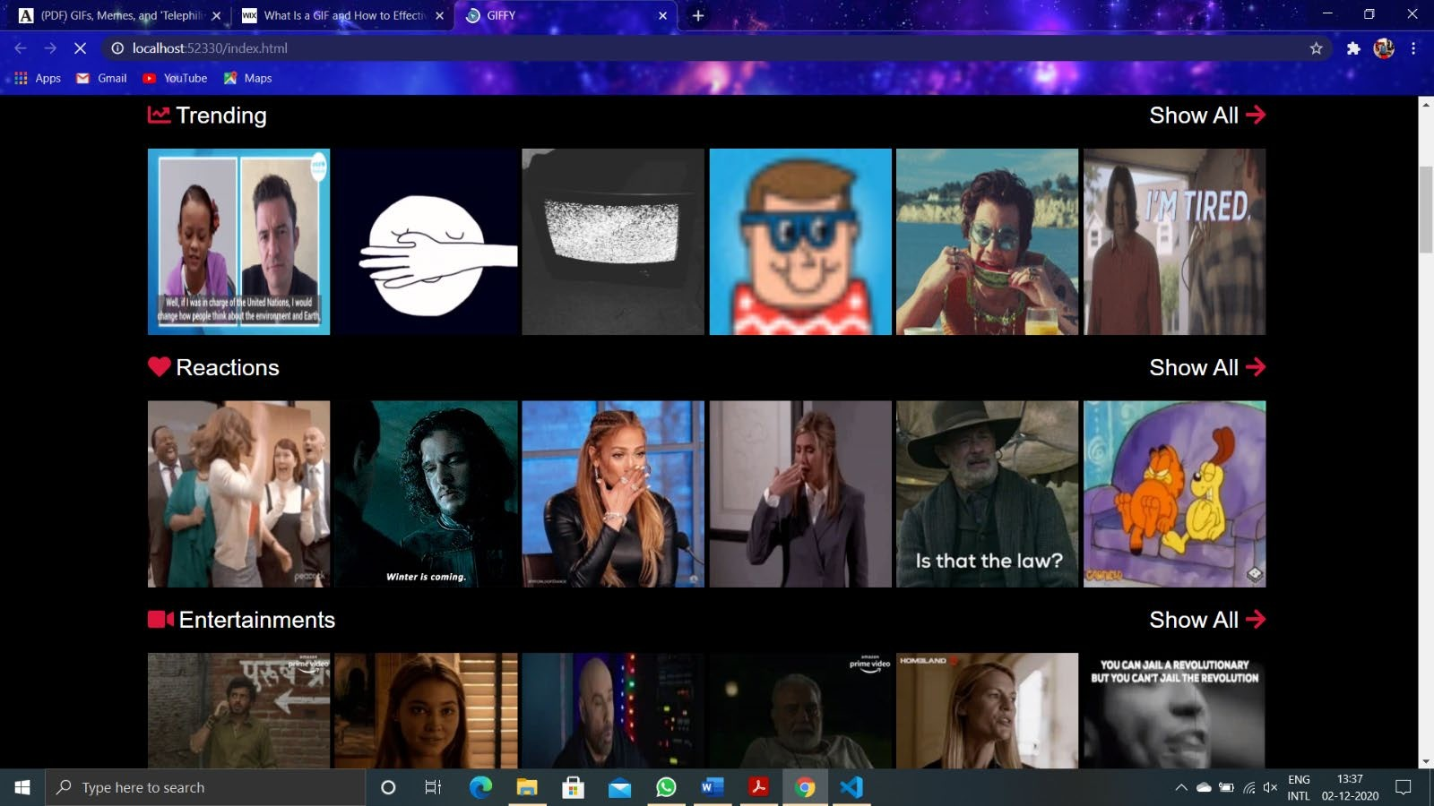
HOME PAGE
This is the main webpage that contains all the information about the Giffys and hyperlinks to other utilities.

Slide 10
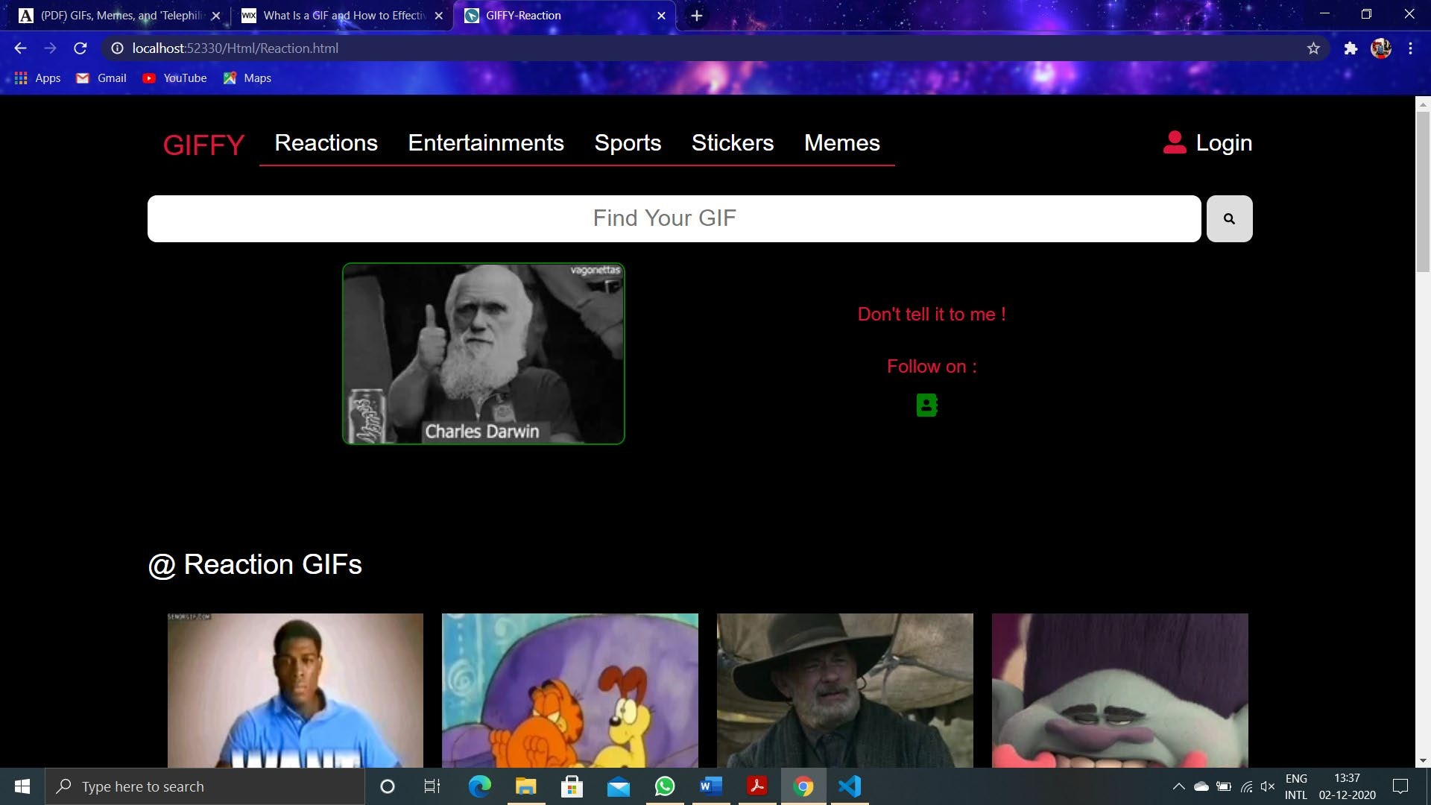
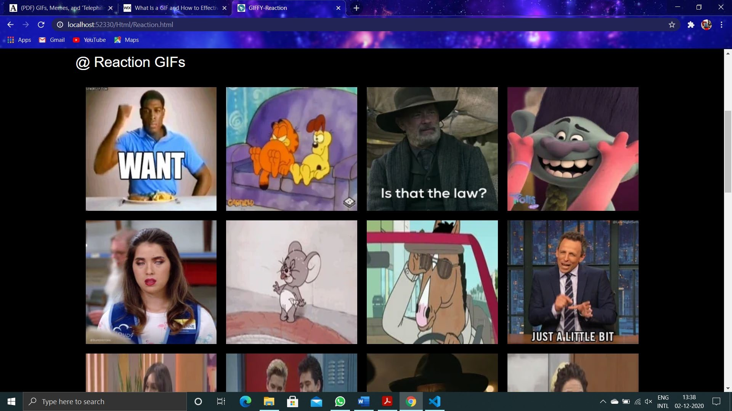
Reaction Page:
This is the webpage that contains all the reactions gifs.

Slide 11
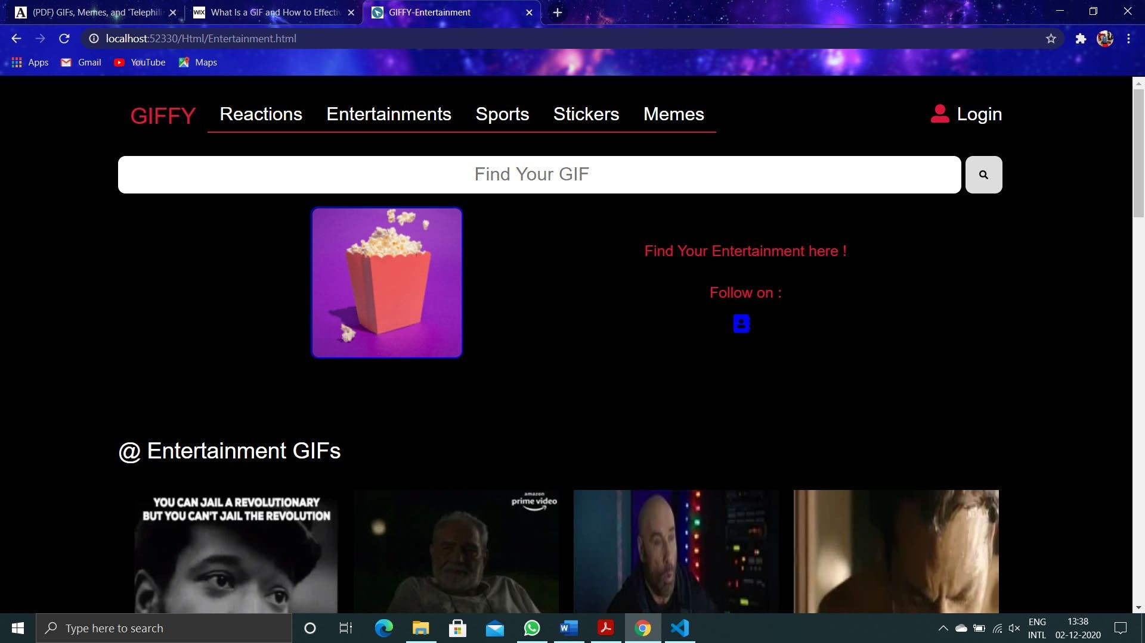
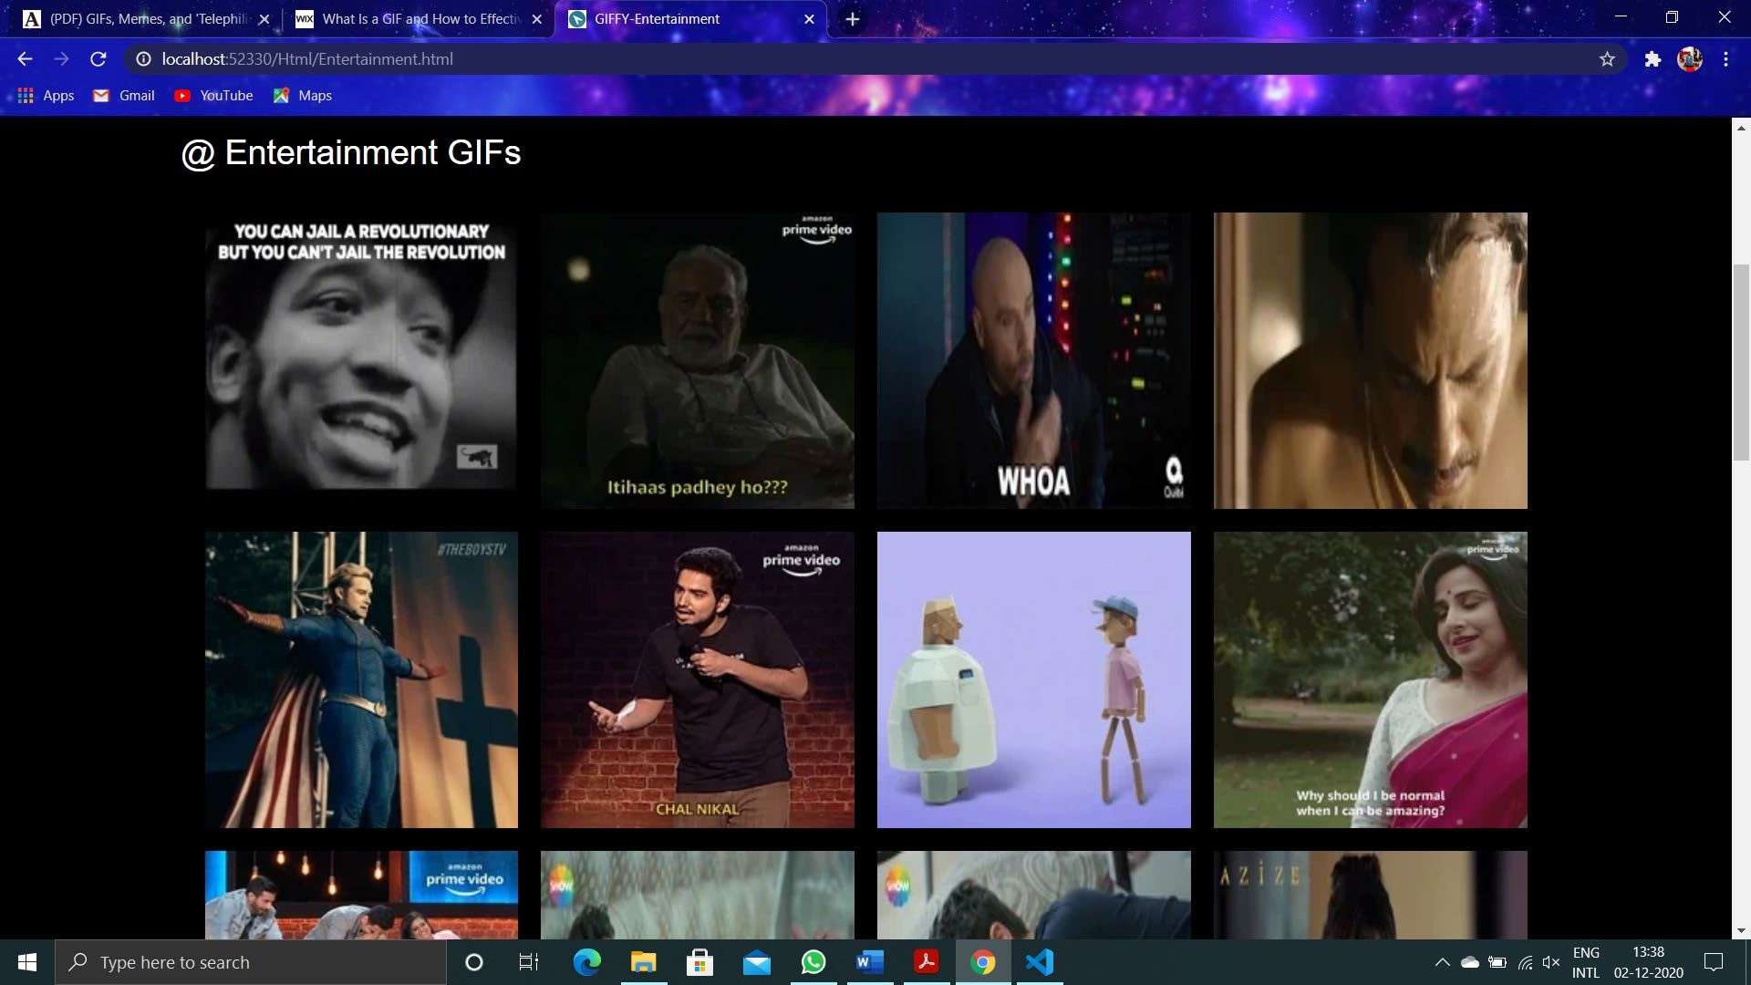
Entertainment Page
This is the webpage that is displayed to the users all the entertainment GIFs .

Slide 12
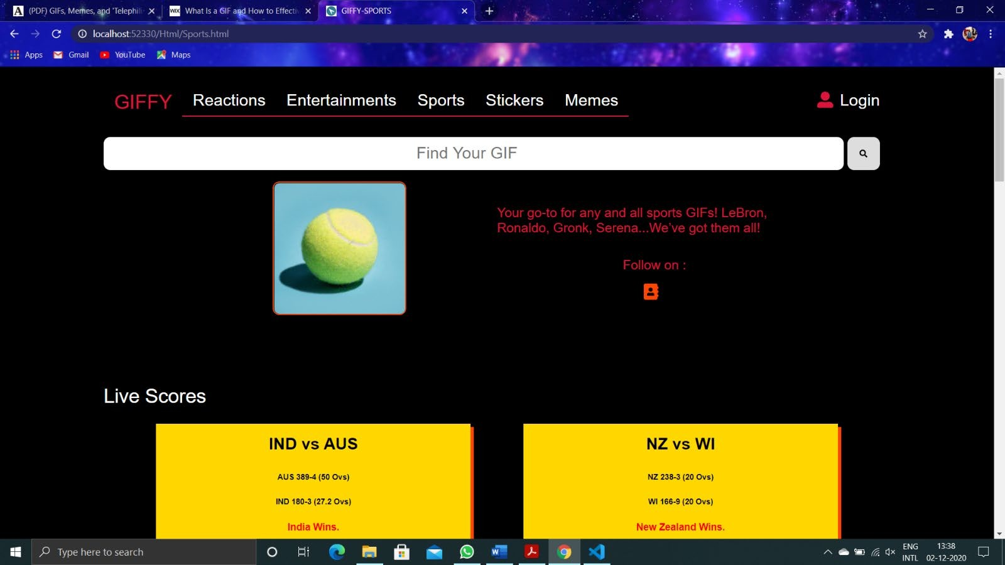
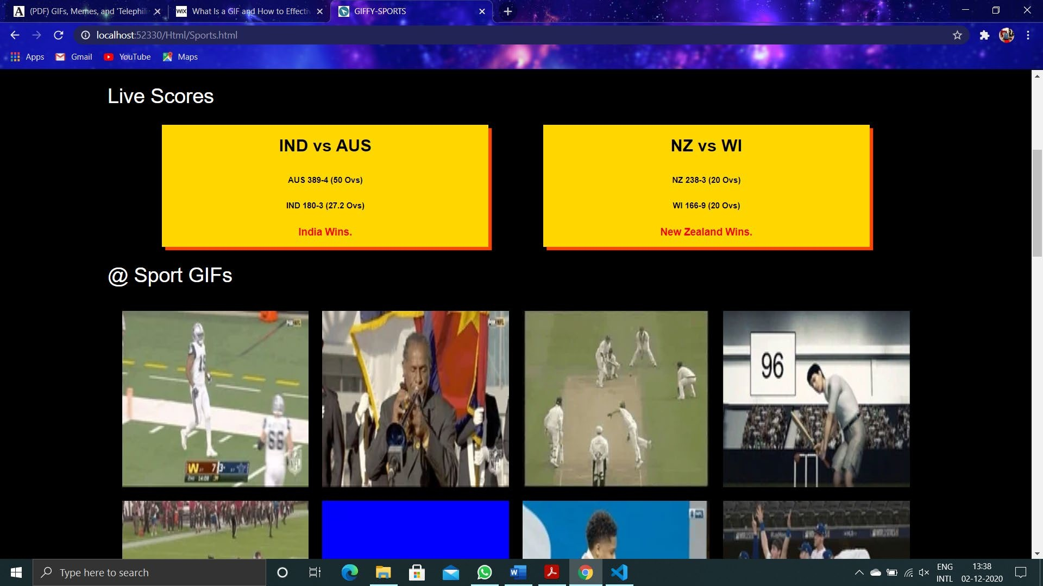
Sports Page
This is the webpage that contains all the information and GIFs related to sports.

Slide 13
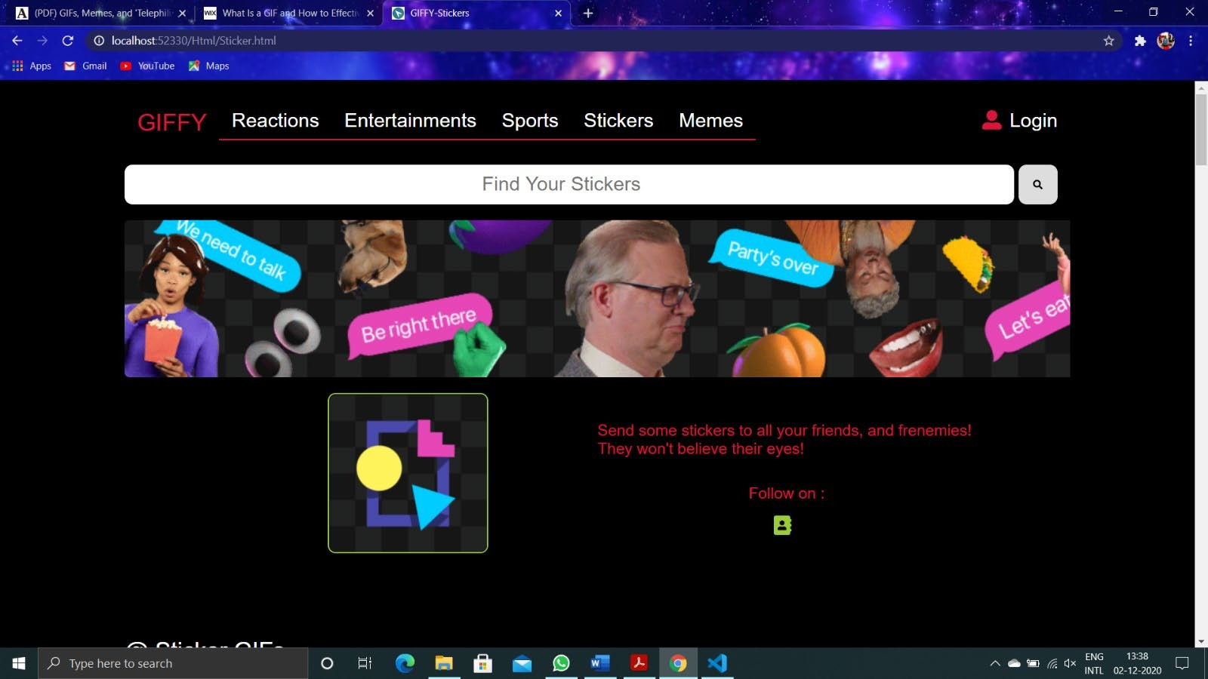
Stickers Page
This is the webpage that contains many stickers.

Slide 14
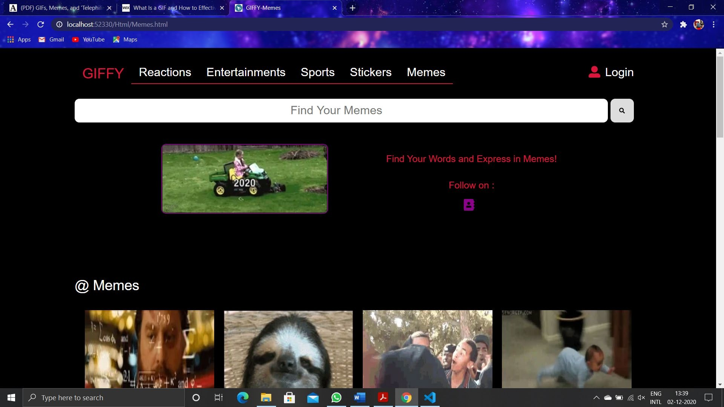
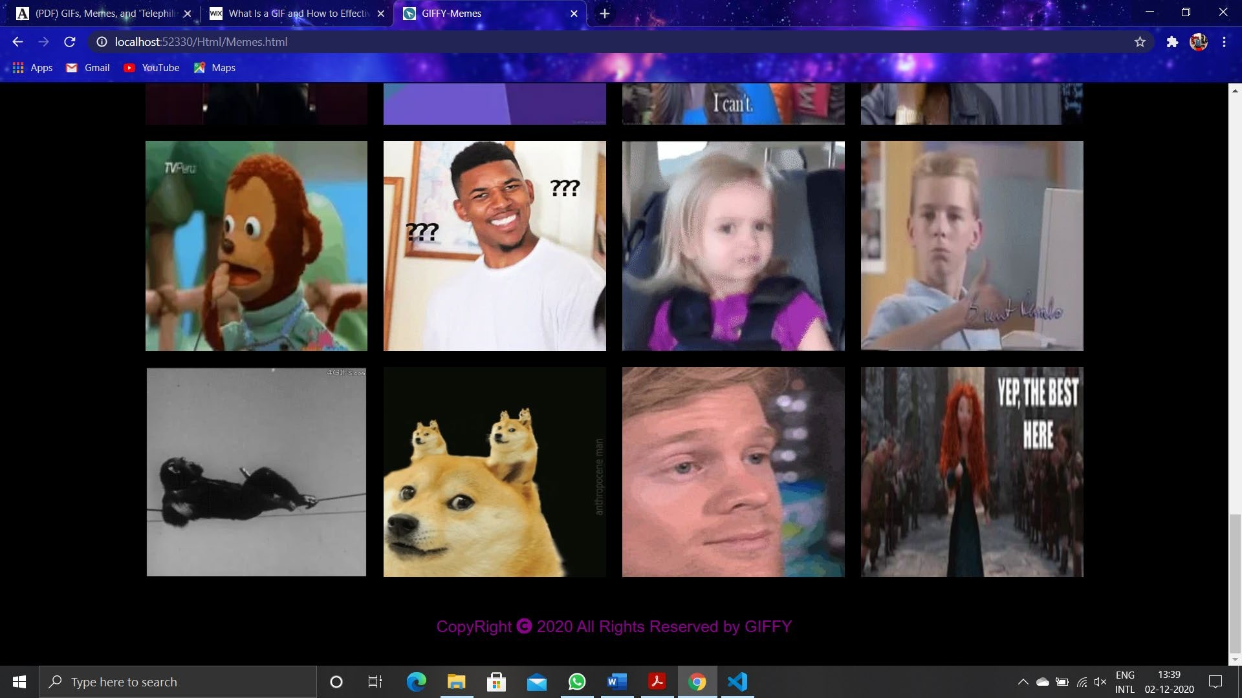
Memes Page
This is the webpage that contains GIFs related to trending memes.

Slide 15
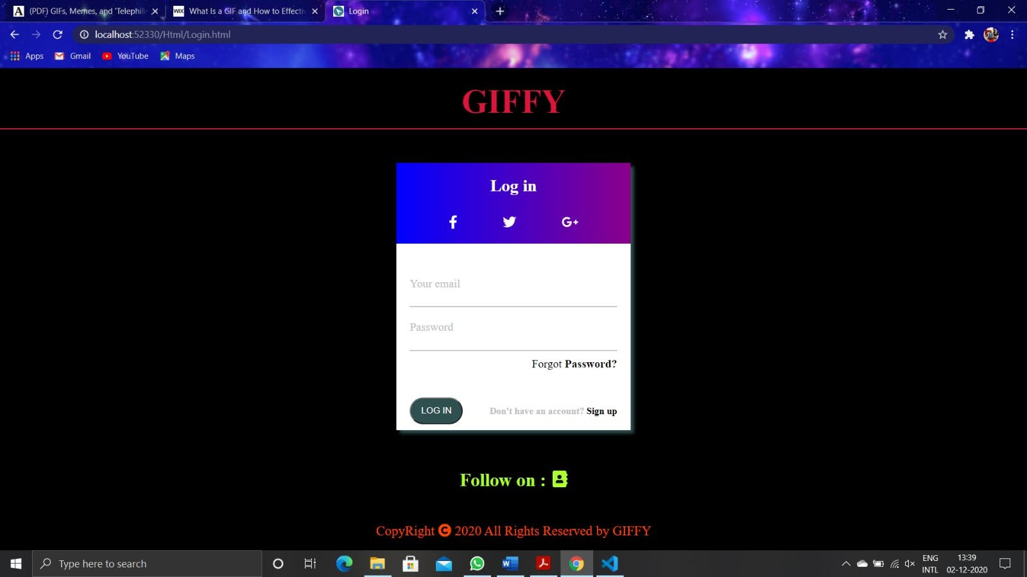
Login Page

Slide 16
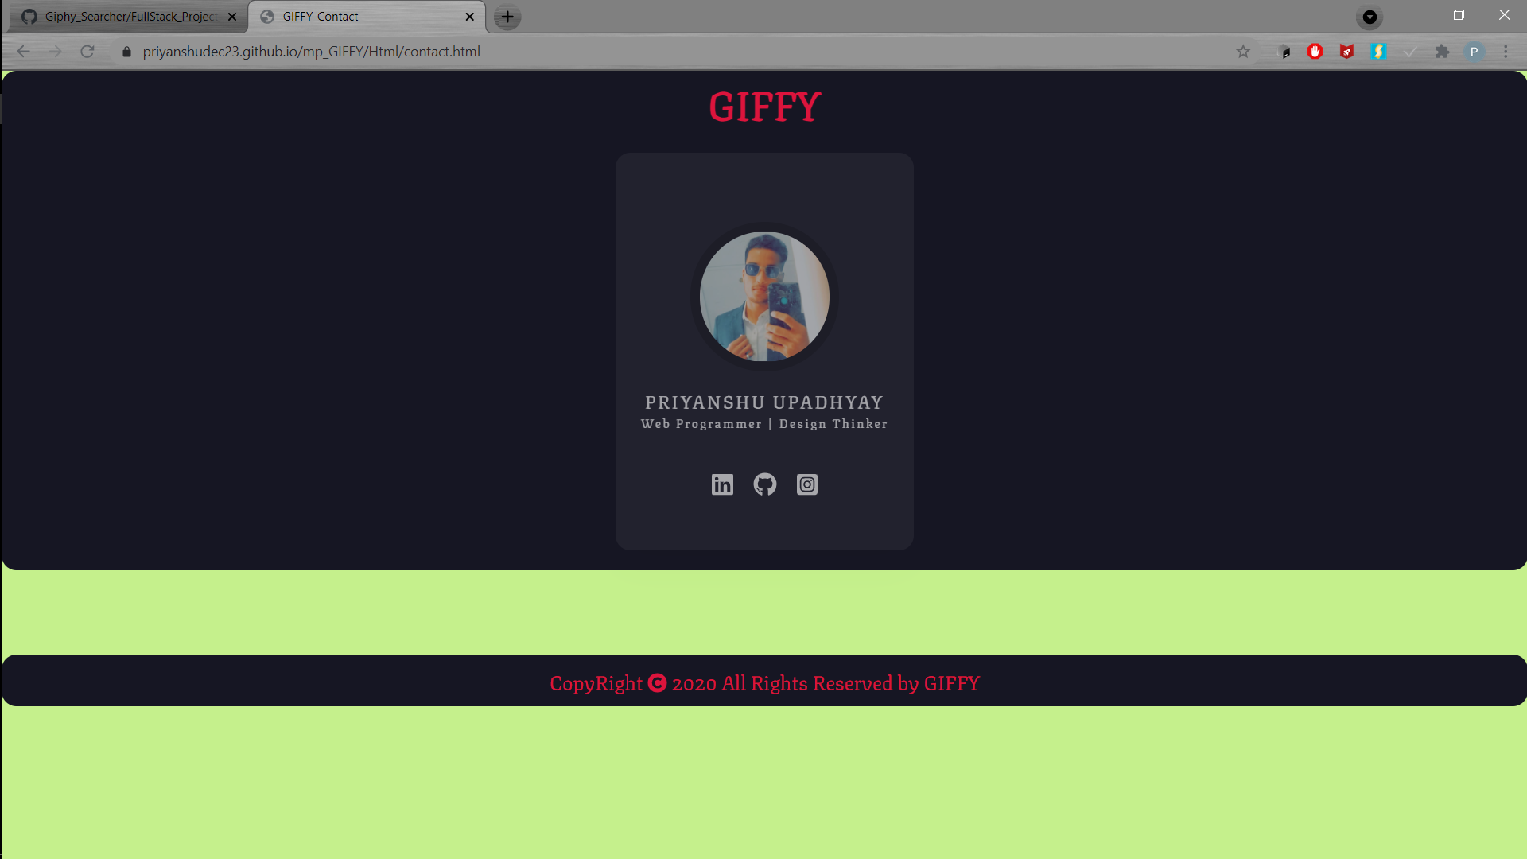
Contact Us Page
This is the webpage that contains contact information by which visitor can get assistance .

Slide 17
REPOSITORY AND LINK
https://github.com/Priyanshudec23/mp_GIFFY.git
LIVE AT:
https://github.com/Priyanshudec23/mp_GIFFY.git

Slide 18
REFERENCES
www.javatpoint.com
www.w3school.com
www.tutorialspoint.com
www.youtube.com
www.giphy.com
www.beta-labs.in

Slide 19
Thank You

